Slide 1

http://bridge-project.org/
Notes:
This PPT is for creating new smaller PPTs on different topics relating to inclusion (one PPt for gender, and one for youth, and one for marginalised groups in general). Not to be shown in one presentation, and/or broken up by small group activities.

Slide 2
This is not a powerpoint presentation designed to be shown in one presentation – it is a set of slides on the topic of political finance regulation that can be used to draw slides from for smaller presentations (on specific topics)

Slide 3
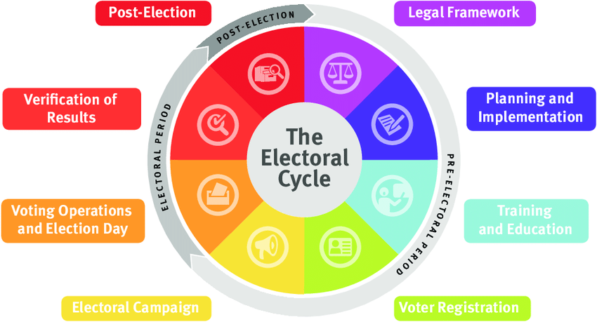
The Electoral Cycle

Slide 4

Inclusion of Marginalised Groups into Electoral Processes

Slide 5
Inclusion of Marginalised Groups into Electoral Processes
Part 1: Quick Brainstorm
Brainstorm all the groups of people who are marginalised or discriminated against in Mongolian society
Part 2: Quick Brainstorm
Brainstorm all the groups of people who are marginalised or discriminated against in electoral processes (as voters, candidates and election workers)

Slide 6
Examples of Marginalised Groups
election staff
voters abroad
absentee voters
refugees and internally displaced persons
nomads and migrants
voters in remote areas
minorities
disabled people
home and hospital bound voters
prisoners
security forces
women
young and first time voters

Slide 7
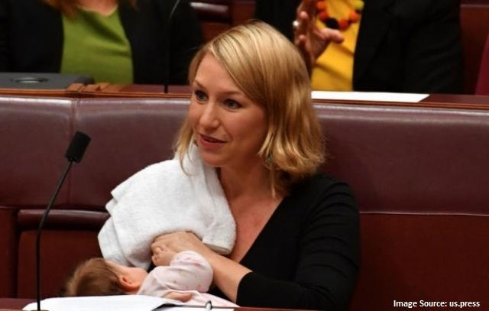
Gender & Elections Overview

Slide 8
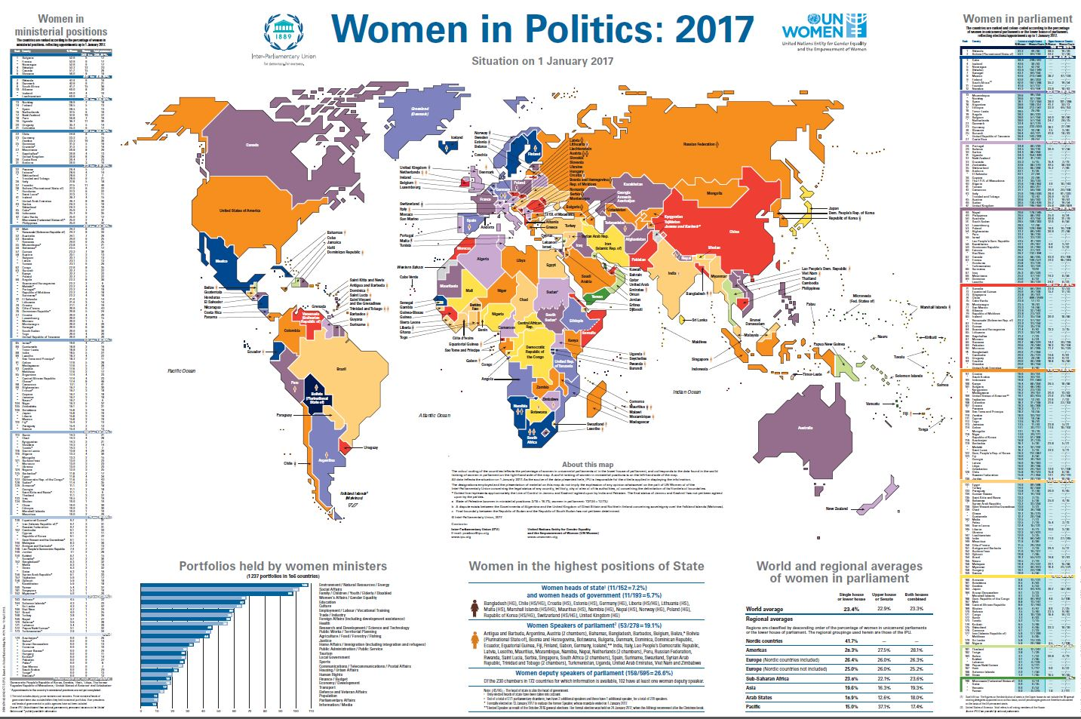

Slide 9
Women in Parliament
Region | Both Houses combined
Nordic countries | 41.5% (just Lower House)
Americas | 26.6%
Europe (excluding Nordic countries) | 25.1%
Sub-Saharan Africa | 22.2%
Asia | 18.4%
Arab States | 16%
Pacific | 15.7%
Global percentage of women in parliament 22.1% (Source: IPU May 2015)

Slide 10
Importance of Gender Equality
Everyone has human rights
Commitments involves obligations (i.e. CEDAW)
Women are 50% of the world’s population
Poverty is a gender issue, 70% of world’s poor are women and girls
Necessary for democracy
Necessary for sustainable human development (gender equality linked with poverty reduction)
Notes:
women make up at least half of a country’s population and if they are marginalized from full and equal participation in political and decision-making processes, a country cannot be considered fully democratic.
the involvement of women in a country’s decision-making and governance is essential to maintaining a vibrant society. Their considerations also often include the needs of their families, broadening the scope of their perspective. Women have different experiences, different needs and different perspectives than men. Involving women and drawing on these differences helps ensure a more representative society, one in which the needs of women and girls are taken into account in the development of policies and programs. Furthermore, societies that are more inclusive of women, especially women with disabilities and women of marginalized groups, are often less violent and more tolerant. This has positive impacts on women, men, girls and boys.
Gender inequality remains a major development challenge in Papua New Guinea. Violence against women is remains unacceptably high; PNG’s systems of family and community relationships often exclude women from leadership and decision making roles

Slide 11
Why women
Should be Involved in Politics
Compliance with human rights legal instruments and principles
Women make up at least half a country’s population
Women have different needs and perspectives to men. Their involvement helps create and maintain a vibrant society and development of policies and programmes where the needs of women and girls and other marginalised groups are taken into account
Societies that are more inclusive of women are often less violent and more tolerant

Slide 12
International Instruments (Gender)
The Universal Declaration of Human Rights (1948)
International Covenant on Civil and Political Rights (ICCPR) (1966)
Convention on the Elimination of All Forms of Discrimination against Women (CEDAW) (1979)
Beijing Declaration and Platform of Action (1995)
UN General Assembly Resolution 66/130 (2011) on Women and Political Participation
United Nations Security Council Resolution 1325 on Women, Peace and Security (UNSC 1325)
Convention on the Rights of Persons with Disabilities (CPRD)
2030 Agenda for Sustainable Development
Notes:
Convention on the Elimination of All Forms of Discrimination against Women (CEDAW), which articulates that women’s equal right to participation in public and political life includes eligibility for election to all publicly elected bodies and participation in the formulation and implementation of policy. The Convention commits state parties to take all appropriate measures to eliminate discrimination against women in the political and public life of the country, including through temporary special measures.
The meaning and scope of temporary special measures are further outlined in general recommendation No. 25 (2004) of the CEDAW Committee, and are broadly defined to include legislative, executive, administrative or other regulatory instruments, policies and practices, including the allocation of resources, preferential treatment, targeted recruitment and promotion, and numerical goals connected with time frames and quota systems. ‘Under certain circumstances, non-identical treatment of women and men will be required in order to address such diff erences. Pursuit of the goal of substantive equality also calls for an eff ective strategy aimed at overcoming underrepresentation of women and a redistribution of resources and power between men and women.’
The most widely legislated temporary special measures are gender electoral quotas, which set specific targets for increasing the proportion of women candidates for election or reserve seats in a legislature for women members. One-third of all countries, 64 in total, have legislated quotas. However, an increasing trend is the adoption of legislation that provides for the differential allocation of public funding according to gender-equality criteria, which is discussed further below. CEDAW recommendation 25 provides a legal basis for these measures, which promote equal opportunity in political competition.

Slide 13
Why women are not involved to the extent they should be
Cultural norms and traditions
Lack of education
Discriminatory laws
Women tend to be primary care-givers
Lack of gender sensitive policies in political parties
Political gatekeepers, internal democracy and a male bias in parties
Electoral systems influencing choice of candidates by parties
Lack of gender sensitive parliamentary working conditions
Lack of funding for political campaigns
Lack of self confidence

Slide 14
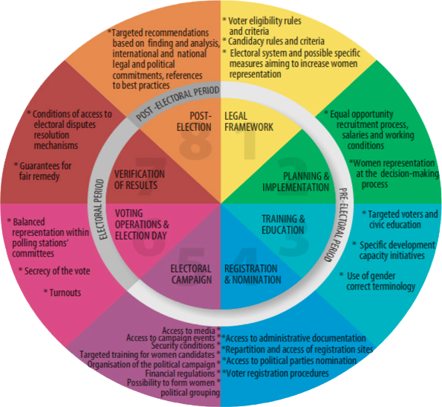
The Electoral Cycle - Gender Activities

Slide 15
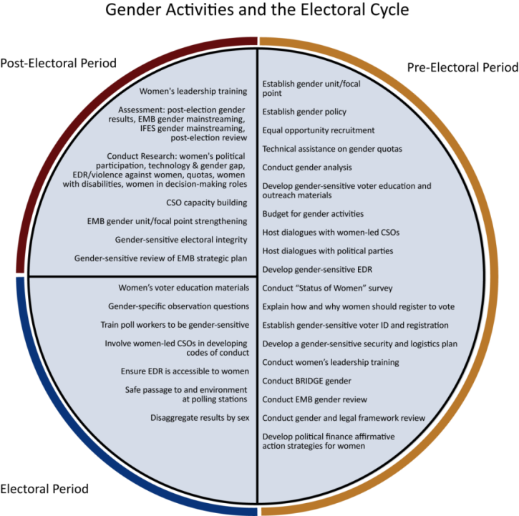
Gender Activities & Election Cycle

Slide 16
Strategies to Address Low Participation of Women in Electoral Processes
Legal framework: electoral law, Special Measures/Quotas, Electoral Systems, Campaign Finance with gender provisions, Election Dispute Resolution, Campaign regulations, media regulations
Civic and Voter Education: targeted campaigns
Training: gender-sensitive training
Voting Registration & Voting Process: more gender-friendly

Slide 17
Promoting Equal Rights and Opportunities in Elections
68 countries globally provide gender-based rule in the candidate nomination or composition of the highest elected body of legislation – quota rules, gender parity rules, minimum targets, recommended approaches.
44 from these relate to legislated candidate quota or gender parity requirements as part of the electoral laws at national or subnational levels;
12 countries with legislated candidate quotas require a strict alternation between female and male candidates on candidate lists for at least one level/house within the legislature (known as zipper or zebra systems)
Notes:
IDEA (get recent stats)

Slide 18
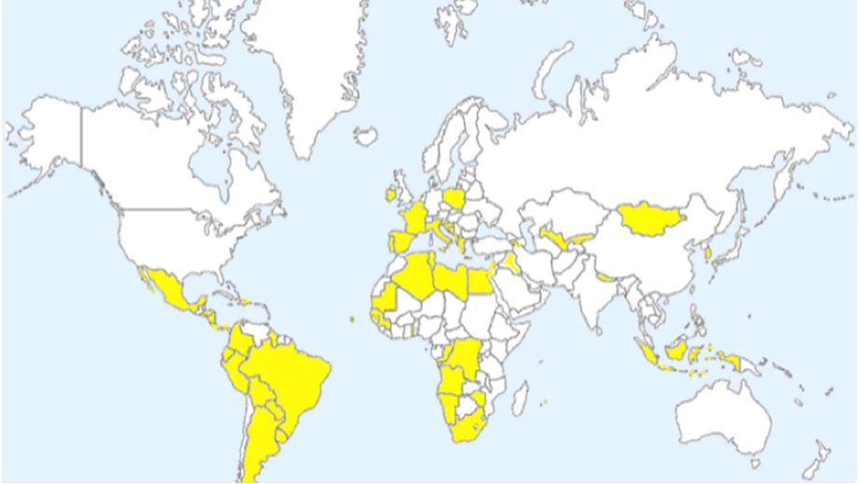
Legislated Candidate Quotas

Slide 19
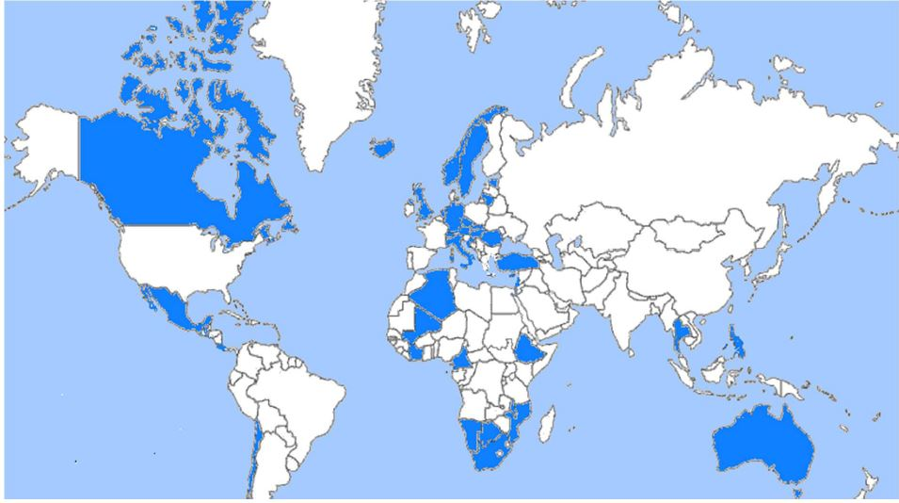
Voluntary Quotas

Slide 20
Gender and Political Finance
Individual contributions overwhelmingly comprise the most important source of financing for all candidates, both women and men
The average size of individual donations to most female candidates continues to be smaller than the average donation to male candidates
The vast majority of large donors to political campaigns are men
Female candidates generally depend upon female donors for financial viability and win monetary support from men only as their odds of election approach certainty
Women who win raise significantly more money than women who lose, while male winners collect only marginally more money than their losing counterparts.

Slide 21
Financial Incentives
Waiving internal candidate-registration fees or establishing a fund to pay the candidate-registration fees of female candidates (if fees are required by legislation);
Reimbursing certain campaign costs for women candidates, such as child care and transport costs in large constituencies
Offering women privileged access to a party’s donor list and creating a separate list of donors willing to support women politicians;
Creating special fundraising networks and organizing fundraising events to support female candidate EMILY’s Lists, Australian Emily’s List; UK fund for Women;
Earmarking a portion of party finances (including public funds, if applicable) for women’s groups, candidates and/or capacity-building training for women candidates
Offering in-kind contributions and support, for example, in the form of training programmes, allocation of free broadcasting time, use of private mass media time and/or access to party property (physical as well as party resources)

Slide 22
Public Funding Linked with
Gender Based Criteria
Serbia
Portugal
France (3/4 decrease in public funds)
Croatia
Bosnia 10 % additional funds
Ireland- half decrease
Italy – for European Parliament
Georgia
Romania

Slide 23
Work and Family Balance
Consider adapting legislative and public policy provisions regarding parental leave, working hours and working environments to political party contexts.
Consider how to provide child care facilities and services during party conferences or congresses
Create financial incentives and allowances for party members on parental leave
Allow for flexible work arrangements

Slide 24
Women’s Wing Structure
National, regional, local branches
Linkage to “mother party”
Representation on decision-making bodies
Funding and resources
Risk: can marginalize women
Notes:
SLIDE CONTENT: One way for parties to promote the inclusion of women is through the establishment of a strong women’s wing. As we noted earlier, a wing is a party subgroup. Like the “mother” party, the wing can have branches at the regional and local levels. It is critical that the wing have strong linkages to the mother party. Ideally the wing should have representation on central decision-making bodies within their parties. Wings should also receive funding from the party or be permitted to raise their own funding. Ideally mother parties would also provide wings with office space within their national and branch headquarters. At every level, there needs to be clarity about the exact roles, responsibilities and authority of the women’s wing. If wings are not linked to decision-making bodies and are not given real authority or resources, they risk becoming a way for parties to marginalize and sideline women.
TRAINER NOTE: Ask the participants to describe how their women’s wing is organized. Pass out copies of the handout and read over it with participants. After considering these other options, ask participants if there are changes they would propose to improve upon the structure of their wings. Keep in mind that this may be a sensitive discussion if held during a multi-party workshop.
HANDOUT 4: Women’s Wing Organizational Structures and Relations with the Party

Slide 25
Women’s Wings
Build awareness of gender frameworks
Draft gender equality policies and lobby for and monitor their implementation
Network with women from other parties
Identify and engage male allies
Train women
Encourage and fund women candidates
Lobby leaders on women’s issues
Notes:
SLIDE CONTENT: Women’s wings can engage in a wide variety of activities to promote gender equality and women’s political participation. For example, wings can:
Gather and build awareness of local, regional and international gender equality frameworks such as the Convention on the Elimination of All Forms of Discrimination against Women and the Beijing Plan so that these documents are readily available and so that party activists are aware of the commitments that their country has made.
Gather positive examples of gender policies and organizational models from other parties in their country and internationally and draft a party gender equality policy and revisions that would engender the party’s constitution and statutes. This could include pushing for the establishment of a quota or other affirmative action mechanism to ensure that women have access to leadership positions within the party and to candidate lists.
Network and share experiences with women from local and international parties.
Identify potential male allies within the party and seek their support.
Organize training courses for women party activists on gender, leadership and political skills such as policy development, networking, advocacy and public speaking.
Identify, train and fundraise for women candidates.
Lobbying party leaders on women’s policy issues.
TRAINER NOTE: Highlight responses that participants may have missed during their brainstorm. Provide participants with a copy of the handout.
HANDOUT 5: Women’s Wings Fact Sheet

Slide 26
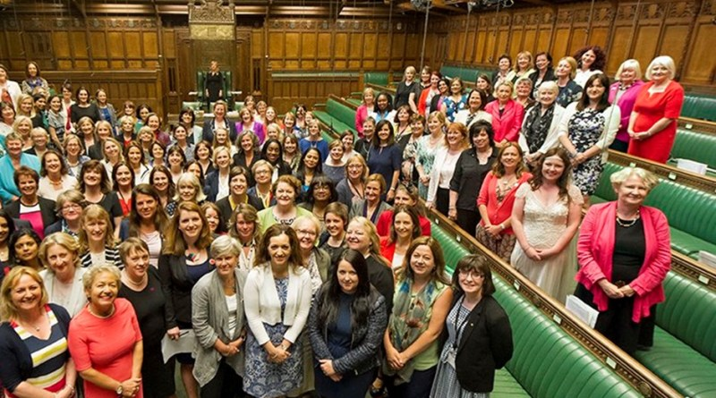
Women’s Parties
Formed in many countries
Success has been limited
Prompted discussions on women's rights and political participation
Notes:
SLIDE CONTENT: One extreme step that some women have taken when they were met with resistance within their parties was to start parties of their own – parties for women! Women's political parties have been organized in countries such as Armenia, India, Lithuania, Northern Ireland and Russia. In many countries, women’s parties did not diversify their platforms and move past issues of women's participation, making it difficult for them to resonate with a wider cross-section of the population. In cases where they developed more comprehensive platforms, they were seen as similar to more established parties, apart from their concentration on women's participation in politics. Some parties enjoyed limited success, in part because they appealed to positive traditional stereotypes associated with women. For example, the women’s party in Russia capitalized on the public opinion that they were "motherly figures" that could save the country. In Northern Ireland, the women's party was seen as being apart from the violent conflict.
While their success has been limited, in many places they have prompted a discussion on and support for women's rights and roles in a country's political system. For example, the presence of women's parties in elections has, in some cases, helped increase support for women candidates from mainstream parties.
TRAINER NOTE: Ask participants whether they think women’s parties could be effective in their country. Why or why not?

Slide 27
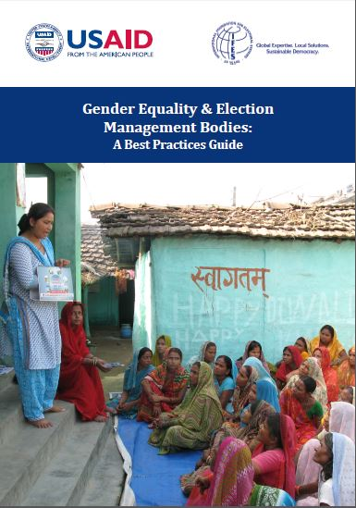
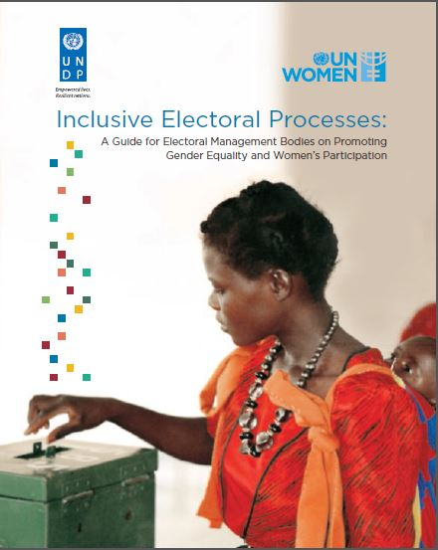
Good Resources

Slide 28
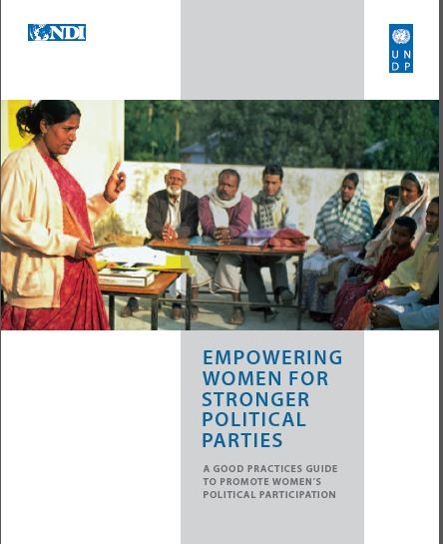
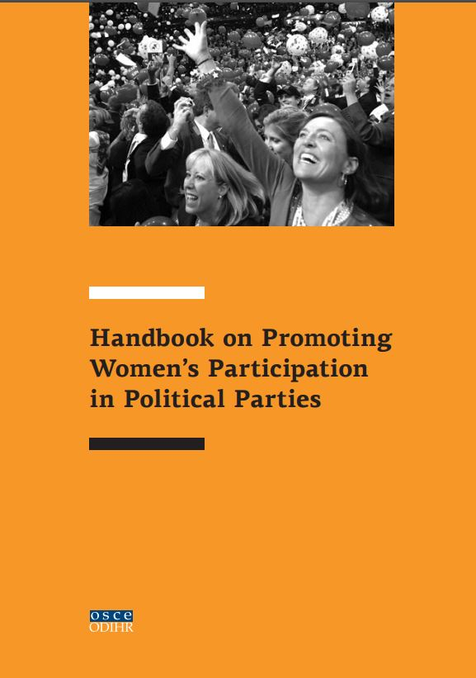
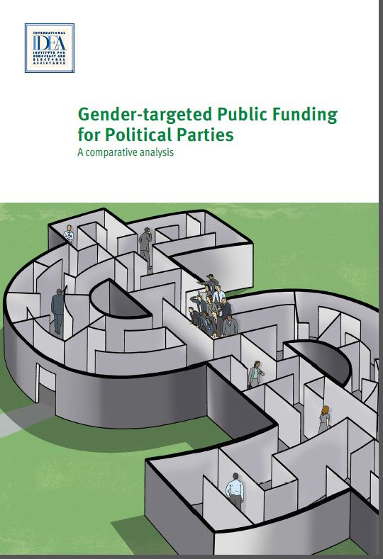
Good Resources
Notes:
Gender-targeted Public Funding for Political Parties
A comparative analysis, 2018

Slide 29
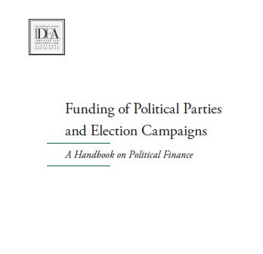
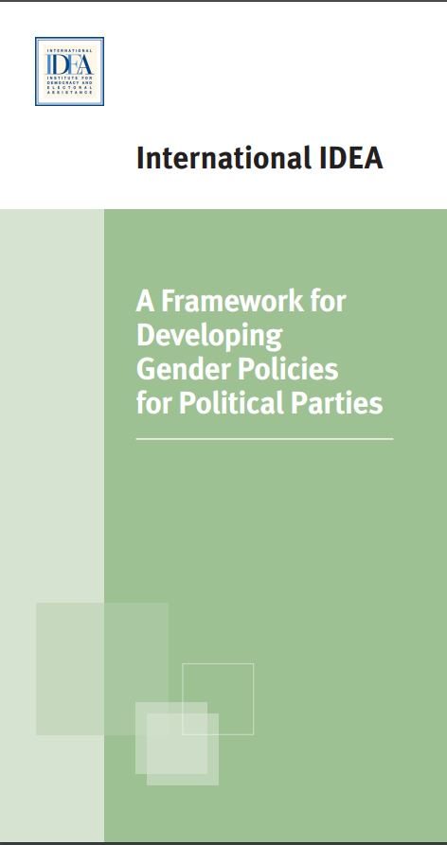
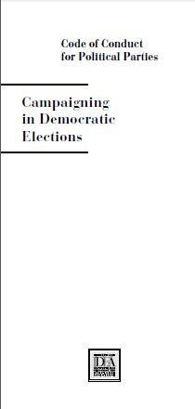
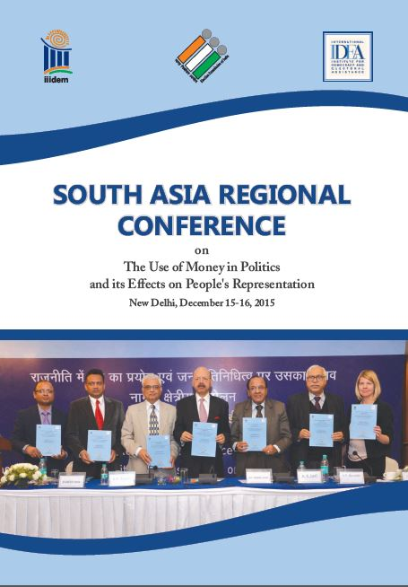
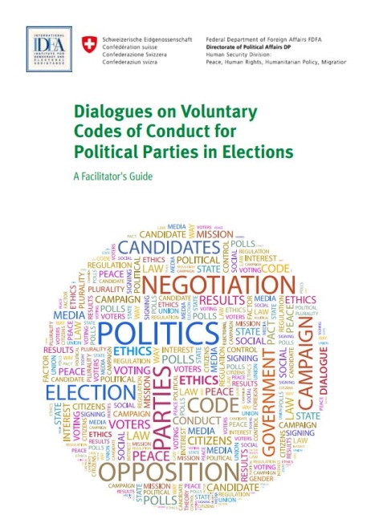
Resources for Political Parties

Slide 30
Examples of Good Gender Practices

Slide 31
Improve Party Democracy
South Africa Rule 6 of the African National Congress’ Constitution (South Africa) states that:: “With the aim of full representation of women in all decision-making structures, the party will implement a programme of affirmative action including quota of not less than 50 percent of women in all elected structures. “
Notes:
Several political parties include equality clauses in their vision statements and party bylaws. For example, in El Salvador, the mission statement and ethics code of the Farabundo Marti Front for National Liberation (FMLN) include a clause on political equality for women. Alongside with addressing gender equality in its statutes and regulations, the Citizens’ Action Party (PAC) in Costa Rica also established a Prosecutor’s Office on Gender Equality, which was mandated to monitor, report, and advise on how the regulations were being implemented
India: The national executive committee of the Bhatariya Janata Party (BJP) amended its constitution in 2008 to reserve 33 percent of the party’s leadership positions for women and make the chief of the national women’s branch a member of the party’s central election committee.
Germany: The Christian Democratic Union (CDU) adopted a 33 percent quota for party officials in 1996. If the quota is not met, the internal elections must be repeated.1
Set targets for participation in party conventions In many political parties, annual party conventions are where policy is set and major party decisions are made. In almost all political parties, conventions provide opportunities for delegates to build the political and financial relationships necessary for successful political careers. Political parties may therefore establish targets to ensure that a proportion of the delegates attending are women. For example, in the United States the Democratic Party has adopted rules for the participation of women delegates at national party nomination conventions. As a result of internal lobbying by women members and support from party leaders, the party’s Charter requires that nominating convention delegates comprise equal numbers of women and men.
In addition, implementing separate forums for women delegates to meet at party conventions offers important networking opportunities. In Australia, the Labor Party’s Women’s Organization holds its own conference every year to provide women with the opportunity to discuss policy, to lobby on specific issues, and to network with each other. In El Salvador, the FMLN’s Women’s Secretariat organizes an annual conference of the party’s women leaders, bringing together office holders and members of the party’s executive board to formulate gender equality strategies and policies. It is important that the resolutions taken in these women’s forums are formally adopted and used to guide the direction of the party on policy matters.

Slide 32
Examples Good Practice
Targeted funding based on eligibility
Targeted funding based on allocation
  Receiving more money if gender criteria is reached, or per woman nominated or elected
  Receiving less money if target for gender balance not achieved
  Earmarking the use of parts of public funding
Notes:
Targeted funding based on eligibility describes systems in which political parties can only access all or part of the public funding if they comply with certain regulations on gender equality, usually that they achieve a certain level of gender balance among their nominated or elected candidates. In practice, this is commonly done by setting aside a certain proportion of the dedicated public funding, and making this accessible only to parties that have complied with such provisions.
The most extreme version of tying public funding to gender equality is one where parties that do not meet certain criteria receive no public funding at all. Systems that do not allow the candidates submitted by political parties on to the ballot if the party has failed to meet an established gender quota regarding their candidates or candidate lists usually fall within this category.
The second type of gender-related public funding is one where the allocation of money to political parties depends on the level of gender equality demonstrated by each political party, most commonly the gender balance among the candidates selected by each party. The formal difference is that with eligibility provisions, a certain proportion of the total public funding is only available to parties that achieve a certain level of gender equality, or that parties that do not reach this level are denied public funding altogether. Allocation provisions, by contrast, mean that parties receive more or less public funding depending on the level of gender equality among their candidates. Allocation provisions can include either the addition or the withdrawal of public funding, and can therefore function as either a carrot or a stick. The difference between eligibility and allocation provisions for political parties and female candidates may in some cases be quite small.
The most straightforward system is to provide additional public funding for each woman candidate who is either nominated or elected
In Chile parties receive a flat rate of additional public funding for each woman candidate from that party who is elected. In Croatia parties receive an additional 10 per cent of the amount envisaged for each member of parliament for each woman elected. A temporary measure in Solomon Islands provides for increased public funding to any party that has at least one woman elected to parliament, although only one woman was elected in the most recent election. Less detailed provisions are in place that allow for increased public funding in relation to the number of female candidates nominated by parties in Ethiopia, Romania and South Korea.
It is also possible, albeit unusual, to relate public funding to the share of the vote that female candidates attract. In Papua New Guinea female candidates who gain at least 10 per cent of the vote earn their political parties an additional flat rate in public funding. (This is the only allocation system that uses a threshold, although in this case set as a share of the vote, not of women as candidates.)
In Brazil and Italy parties must use at least 5 per cent of their funds to promote the participation of women. There are also provisions in Brazil that a certain share of the airtime given to each political party must be devoted to promoting political participation by women. Meanwhile, in Chile, Honduras, Panama and South Korea 10 per cent is earmarked for gender-related activities. A more modest provision in Mexico requires parties to use at least 2 per cent of their public funding for such purposes.
In Colombia, for example, not less than 15 per cent of the funding for each political party must be used to increase the participation of youth, women and ethnic minorities, while 30 per cent must be used for similar purposes in Kenya

Slide 33
Papua New Guinea, Georgia
It is also possible to relate public funding to the share of the vote that female candidates attract. In Papua New Guinea female candidates who gain at least 10 per cent of the vote earn their political parties an additional flat rate in public funding.
In Georgia, political parties that receive public funding are entitled to 30 per cent additional funding if their candidate lists have at least 30 per cent of each gender in the first 10 names (with the same principle applying to the next two sets of 10 candidates on a list).

Slide 34
Examples of legislation regarding candidate quotas on nomination to be enforced by the EMB

Slide 35
Armenia
Neither gender may exceed 80 percent in the list of every five candidates on the proportional representation list (starting from the second entry) (Article 108, paragraph 2, Electoral Code of Armenia, 2011).
The Central Electoral Commission shall reject the registration of the electoral list of a political party, an alliance of political parties if the electoral list does not meet the requirements defined by Article 108(2), including the legislated candidate quota (Article 110, Electoral Code of Armenia, 2011).

Slide 36
Bosnia and Herzegovina
Every candidate list shall include male and female candidates who are equally represented. Equal representation is reached when each gender is represented with a minimum of 40 percent of the total number of candidates on the list (Article 4.19 [4]).
The under-represented gender shall be distributed on the candidates list in the following manner. At least one (1) minority gender amongst the first two (2) candidates, two (2) minority gender candidates amongst the first five (5) candidates, and three (3) minority gender candidates amongst the first eight (8) candidates, etc. (Article 4.19 [4]). If a list does not comply, only the part of the list up to the number fulfilling the requirements in the law shall be accepted by the Central Elections Commission (Article 4.19 [8]).

Slide 37
Ecuador
According to the Electoral Law 2009 and 2012, Article 99, in the candidate lists, for the elections through the system of proportional representation, the names of men and women candidates will be presented alternatively until the end of the list.
The candidate lists will be rejected by the Electoral Commission if they do not comply with the gender parity provisions of the Constitution and the Electoral Law (Electoral Law 2009/2012, Article 105)

Slide 38
Examples of legislation regarding disbursement of public funding and proportion of women candidates

Slide 39
Albania
For each electoral zone, at least 30 percent of the multi-name list and/or one of the first three names on the multi-name list must be from each gender (Article 67, paragraph 6, Law no. 10 012, 2008 amended by the law no. 74/2012).
Failure to comply is punishable with a fine of ALL 1 million (EUR 7,120) in the case of elections to the Assembly and ALL 50,000 (EUR 346) for elections for local government bodies for each electoral zone.

Slide 40
Burkina Faso
Lists of candidates must include at least 30 percent of either sex (Law on Quotas, Article 3).
If a party reaches or exceeds the 30 percent quota, it will receive additional funding (Law on Quotas, Article 5 & 6).
If a political party fails to meet the quota provision, its public funding for election campaigns will be cut by 50 percent. (Law on Quotas, Article 5 & 6).

Slide 41
Ireland
According to the Electoral Act 1997, section 17, as amended by the Electoral (Political Funding) Act 2012, section 42, the political parties, after the implementation of the law in national elections, will lose 50 percent of their state funding, unless at least 30 percent of their candidates are women and at least 30 percent are men. After a period of seven years, the political parties should have a 40-percent gender quota in their candidate lists in order receive full state funding.

Slide 42
Panama
The Electoral Law 54 of 2012 states that 50 percent of the public financing destined to political parties must be allocated for the training of party members and, from this, 10 percent must be specifically used for the training of women.

Slide 43
Portugal
Candidate lists, for the elections to the national parliament, European Parliament and local governments, shall be composed in a way such as to promote a minimum representation of 33 percent of each sex (Decree 72, 2006).
If a list does not comply with the quota law, this will be made public and there will be financial sanctions in relation to the level of inequality on lists (Decree 72, Article 7).

Slide 44
Chile
In Chile, for the next four electoral cycles (starting in 2017), the reformed electoral law will establish a higher compensatory amount for women candidates for every vote won, designed to help reimburse campaign expenses—irrespective of whether a women candidate won or lost the election. In addition, there will be an increased amount of public funding to parties for each female candidate elected. The reformed electoral law requires parties to nominate not less than 40 per cent or no more than 60 per cent of women and men on their candidate lists.

Slide 45
Romania
state funding allocated to eligible political parties is increased in proportion to the number of seats obtained by women candidates

Slide 46
Ireland
the women’s wing of the Labour Party has developed an initiative to address the ‘five-Cs’ they have identified as affecting women: care, culture, cash, confidence and candidate selection. The party fundraises on behalf of female candidates, with an emphasis on supporting new or first-time candidates

Slide 47
United States, Australia
EMILY’s list (Early Money is Like Yeast) is a partisan fundraising network of the Democratic Party that collects funds on behalf of women candidates and seeks to alleviate disparities between male and female candidates by providing ‘seed money’, or early money, for women’s campaigns, especially for the primaries. Funds are either donated directly to the candidate or spent on their behalf.

Slide 48
Canada
the Liberal Party provides subsidies to women candidates for childcare during the party nomination process, and an additional sum for travel costs in geographically large electoral districts

Slide 49
Mexico
each party has to devote 2 per cent of its regular annual public funding for the training, promotion and development of women leaders.

Slide 50
France
In 1999, France adopted a law tying public funding to respect for the gender quota. Under the law, if the gender gap between male and female candidates is larger than 2 per cent, the public funding is reduced by three-quarters of the difference

Slide 51
South Korea
South Korea introduced a 30 per cent mandatory quota in 2002 combined with additional funding to parties that nominated women above this threshold, but this rule was repealed in 2005
Such an approach would mean that if the party exactly meets the quota, its candidates would appear on the ballot, but if the party exceeded the quota threshold by nominating more women, it would be increasingly rewarded financially. It would also be possible to encourage parties to nominate women above a set quota if they received a reduction in public funding for failing to reach full parity.

Slide 52
Haiti
Haiti’s 2006 Law on Political Parties and 2008 Electoral Law state that political parties that run at least 30 per cent women candidates (and succeed in electing 20 per cent of them) will have double the public funding after the election.68 Th e legislation also requires that 50 per cent of these funds be used to support women candidates and political education. Haiti has a new constitutional amendment (adopted in 2012) that requires a minimum 30 per cent quota for women in all elected and appointed positions; it has not yet been enforced as no elections have been held since then.

Slide 53
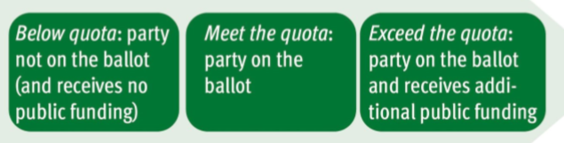
Combination of quota as candidacy requirement and gender-targeted public funding

Slide 54
Burkina Faso
Political parties that do not meet the requirement to place at least 30 per cent of either sex on their candidate lists are deprived of 50 per cent of their public funding.

Slide 55
Portugal
June 2018: Portugal will likely increase the gender quota in party lists from the current 33% to 40%, meaning more than the current 1 in each 3 candidates (minimum 33% in total). The two top candidates will also need to be balanced in gender. Portugal has a PR system, with closed lists.
The penalty for infringing this will be the rejection of the list - and not a cut in public financing, as it is the case today.

Slide 56
Morocco
the government has created a support fund to encourage women’s representation, which finances projects that strengthen women’s capacities.

Slide 57
Costa Rica
In Costa Rica, the Citizens’ Action Party has created an Office for Gender Equality, under the internal election board, which works to implement all the requirements on gender equality set out in the party’s statutes, especially regarding horizontal parity in the party lists they present for elections

Slide 58
In an effort to encourage more women to run for office, most political parties in Ghana have voluntarily halved the fees associated with the registration of candidates for women.
In Togo, the nomination fee is 25 per cent lower if a party list contains female candidates.
In Nigeria, different initiatives run by CSOs aim to help female candidates finance their campaign by providing access to low- or no-interest loans for electoral expenses

Slide 59
Kenya
Kenyan legislation states that political parties where more than two-thirds of national office bearers (internal party leaders) are of either gender are not eligible to receive any public funding
30 per cent of the funding for each political party must be used to increase the participation of youth, women and ethnic minorities
Notes:
However, ‘parties that are not serious about gender equality can easily bypass this requirement by simply creating new deputy positions for women that have no real power’ (Ohman and Lintari 2015: 22). Discussions are ongoing about further reforms in line with the gender equality provisions written into the 2010 Kenyan Constitution.

Slide 60
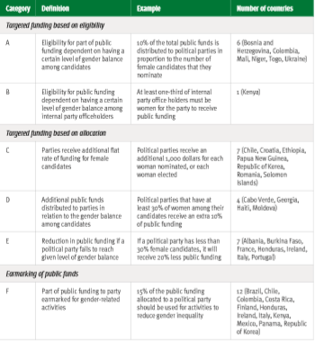
Typology of gender-targeted funding for political parties around the world

Slide 61
Recommendations
Develop and strengthen political parties’ internal rules on the nomination process in order to conduct free, fair and peaceful primaries. Political parties should reduce or waive the payment of nomination fees in order to encourage more women to run for office.
Organize training for male members of political parties to make them familiar with the issue of gender equality and the importance of women’s participation in politics.
Develop intra-party fundraising mechanisms through the establishment of grassroots political networks to support women candidates at the pre-nomination stage by providing them with seed money.
Establish special funds earmarked for women to use to help organize electoral campaigns; ensure that women candidates benefit from a more equitable distribution of campaign financing and other resources
Introduce gendered criteria for the allocation of public funding. For example, the amount of public grant should be linked to the percentage of women candidates put forward by each party or elected to parliament.

Slide 62
And….
For advocacy:
Improve internal political party democracy, e.g. guaranteeing women’s presence in decision-making structures.
Use civil society as partners
Use INGO’s as partners
Use media as partners
Cultivate strategic alliances with men
Adopt a multi-thronged approach
Refer to international commitments that Mongolia is a signatory to
Notes:
strategies require the cooperation of a variety of actors and political parties from across the political spectrum.

Slide 63
No one-size-fits all model
There is no ‘one-size-fits-all’ model—hence, the process of reform to political finance for gender equality/advancement has to be adapted in alignment with the national context, as well as the government’s mandate and its ambition to promote gender equality.

Slide 64
Questions?
Thank You

