Slide 1

http://bridge-project.org/

Slide 2
International Standards for Elections

Slide 3
Session Objectives
To gain awareness of the international obligations/commitments and standards in elections

Slide 4
Credible/Democratic/Free and Fair Elections
Universal
Equal
Secret
Competitive
Notes:
Ask participants to define each of these terms
Elections are central to democracy. Unless they are free and fair – they cannot be said to be democratic.

Slide 5
International obligations/commitments, principles and best practices
Represent a common understanding of what democratic elections should or should not do:
International Public Law, Customary law
International Best Practice
Regional treaties
Declarations & political commitments
International and regional treaties and agreements provide a framework of norms against which a country’s electoral legal arrangements can be deﬁned and assessed.
Notes:
Such principles are usually contained in international treaties and covenants. Yet it is interesting to observe that while international law establishes key minimum standards regarding democratic governance, “it does not establish a stand-alone “right to democracy” per se. This is largely because the term and concept of democracy is too broad and too vague to be regulated by a single legal norm.”[xi]
Nevertheless international law and standards do establish critical rights such as the right to genuine elections as referred to above in Article 21(3) of the UDHR and as set out in Article 25 of the International Covenant on Civil and Political Rights (ICCPR 1966). Together with the UDHR, the ICCPR is among the very leading sources of international standards. In fact, Article 25 of the ICCPR has been referred to as “the cornerstone of democratic governance and genuine elections in international law.”[xii] Of note, the ICCPR has been signed and ratified by more than 160 States thereby making it legally binding in those cases.
International standards are also contained in further United Nations and regional treaties and documents. Important among these are:
Convention on The Political Rights of Women (1952)
Convention on the Elimination of All Forms of Discrimination Against Women (1979)
Convention on the Political Rights of Women (1952)
International Convention on the Elimination of Racial Discrimination (1966)
Convention on the Rights of Persons with Disabilities (2006)
The European Covenant for the Protection of Human Rights and Fundamental Freedoms (1950)
Charter of Paris For a New Europe: CSCE Summit (1980)
The Document of the Copenhagen Meeting of the Conference on the Human Dimension of the Conference on Security and Co-operation in Europe (OSCE-1990)
The American Declaration of the Rights and Duties of Man (1984)
The American Convention on Human Rights (1969)
American Convention on Human Rights (1969)
The African Charter on Human and Peoples’ Rights (1981)
A requirement to adhere to the aforementioned principles in a particular country depends on the inclusion of that country as signatory to the international document. However, the normative guidance delivered by international rules is expected to further encourage promotion and support of international rules and guiding principles beyond simply the signatory countries. The European Union Compendium of International Standards for Elections concludes that legal force notwithstanding, “these instruments have strong political and moral force.”[xiii]When a nation’s legal framework is created or under revision, the nation is bound by the international treaties it has signed. Therefore, electoral rules derived from international treaties have to be upheld and will have even constitutional or statutory rank. Other United Nations’ documents unsigned by a country can, nonetheless, incorporate persuasive electoral standards within the electoral regime of that country.
In addition to international and regional treaties, covenants and convention the review and revision of legal frameworks can also take into account additional references such as:
Political commitments, e.g. League of Arab States (LAS), The Organization of the Islamic Conference (OIC), The Commonwealth, The Organization for Security and Co-operation in Europe (OSCE), The European Union (EU), among other initiatives[xiv];
Final reports from the different missions of electoral observation (both national and international), as long as such reports are available;
Requirements from any additional international agreement signed by the country that may have an impact on electoral laws;
Codes of conduct related to electoral topics and developed by governmental or non-governmental international organizations. (Codes of conduct are considered further in the section dealing with legal instruments.);
Best practices, such as in the areas of transparency, level playing field for electoral contestants, voter education and establishing a peaceful environment for voting, “While not always specifically referred to in universal or regional instruments, many of these practices can be considered essential to a genuine and democratic electoral process.”[xv]

Slide 6
Legal Status of International Instruments
International Customary Law
Binding on all States
Declarations and Political Commitments
Persuasive on all supporting states
International Treaties
Regional Treaties
Binding on all Signatories
Binding on all Signatories
Notes:
What are the bases for international obligations?
Sources of international obligations include:
International and Regional treaties and conventions
E.g. International Covenant on Civil and Political Rights
Binding on Signatories
International Customary Law
E.g. Universal Declaration of Human Rights
Binding on all States
Declarations and Political Commitments
E.g. Declaration on the Rights and Responsibilities of Individuals,
Persuasive on all supporting states
Cases and Judicial Decisions
E.g. United Nations Human Rights Committee, General Comment No. 25
Persuasive on all signatory states

Slide 7
Principal Obligations for Democratic Elections: THE BIG 10!!!
Free Expression of the Will of the People
  Security of the Person
Genuine Elections
  Transparency
  Freedom from Corruption
  Freedom of Movement
  Freedom of Assembly
  Freedom of Association
  Freedom of Expression and Access to Information
  Freedom from Discrimination
Periodic Elections
Universal Suffrage
Equal Suffrage
Right to participate in public affairs
Right to Vote
Right to be Elected
Secret Ballot
Right to Effective Remedy
  Right to a fair and impartial hearing
Notes:
The rights in those articles are more clearly articulated here – THE BIG 10
Drawn from Art. 21 of the UDHR and Art. 25 of ICCPR
Exception of Right to Effective Remedy which is essential for a good electoral process
Genuine Elections
considered by many to include the rights and freedoms that you see listed below, but also includes concept of there being a real contest

Slide 8
The “Essentials”
UNDHR Art 21
ICCPR Art 25
CEDAW
Right to vote
Right to be elected
Genuine elections
Periodic elections
Universal suffrage
Equal suffrage
Secret ballot
Free expression of the will of the electors
Right to Vote
Right to Participation
temporary special measures
Will of the people
Periodic
Genuine elections
Universal suffrage
Equal suffrage
Secret vote

Slide 9
International Instruments (Gender)
The Universal Declaration of Human Rights (1948)
International Covenant on Civil and Political Rights (ICCPR) (1966)
Convention on the Elimination of All Forms of Discrimination against Women (CEDAW) (1979)
Beijing Declaration and Platform of Action (1995)
UN General Assembly Resolution 66/130 (2011) on Women and Political Participation
United Nations Security Council Resolution 1325 on Women, Peace and Security (UNSC 1325)
Convention on the Rights of Persons with Disabilities (CPRD)
2030 Agenda for Sustainable Development
Notes:
Convention on the Elimination of All Forms of Discrimination against Women (CEDAW), which articulates that women’s equal right to participation in public and political life includes eligibility for election to all publicly elected bodies and participation in the formulation and implementation of policy. The Convention commits state parties to take all appropriate measures to eliminate discrimination against women in the political and public life of the country, including through temporary special measures.
The meaning and scope of temporary special measures are further outlined in general recommendation No. 25 (2004) of the CEDAW Committee, and are broadly defined to include legislative, executive, administrative or other regulatory instruments, policies and practices, including the allocation of resources, preferential treatment, targeted recruitment and promotion, and numerical goals connected with time frames and quota systems. ‘Under certain circumstances, non-identical treatment of women and men will be required in order to address such diff erences. Pursuit of the goal of substantive equality also calls for an eff ective strategy aimed at overcoming underrepresentation of women and a redistribution of resources and power between men and women.’
The most widely legislated temporary special measures are gender electoral quotas, which set specific targets for increasing the proportion of women candidates for election or reserve seats in a legislature for women members. One-third of all countries, 64 in total, have legislated quotas. However, an increasing trend is the adoption of legislation that provides for the differential allocation of public funding according to gender-equality criteria, which is discussed further below. CEDAW recommendation 25 provides a legal basis for these measures, which promote equal opportunity in political competition.

Slide 10
International Instruments (Youth)
The Universal Declaration of Human Rights (1948)
International Covenant on Civil and Political Rights (ICCPR) (1966)
The United Nations’ Convention on the Rights of the Child (1989)
The UN World Programme of Action for Youth (WPAY) (1996)
UN General Assembly Resolution A/RES/58/133, Policies and programmes involving youth (2003)
United Nations Development Group - Strategic Action Plan on Young People 2010-2011 (2010)
122nd Assembly of the Inter-Parliamentary Union (IPU) adopted an ambitious resolution on youth (2010)
UNDP Youth Strategy (2014-2017) “Empowered Youth, Sustainable Future” (2014)
Security Council Resolution 2250 on youth, peace and security (2015) General Assembly Resolution Transforming our world: the 2030 Agenda for Sustainable Development (2015)
2030 Agenda for Sustainable Development and the SDG 16
UNDP, Youth Global Programme for Sustainable Development and Peace – Youth-GPS (2016–2020) (2016)
United Nations General Assembly Resolution A/RES/70/127 (2016)
Notes:
The Universal Declaration of Human Rights (1948) has codified everyone’s “right to take part in the government of his country, directly or through freely chosen representatives” (Article 21). The United Nations’ Convention on the Rights of the Child (1989), the most widely ratified international agreement, has affirmed various civil and political rights for all individuals up to 18 years of age, such as the right to participate: “States Parties shall assure to the child who is capable of forming his or her own views the right to express those views freely in all matters affecting the child, the views of the child being given due weight in accordance with the age and maturity of the child“ (Article 12).80 In 1996, the UN General Assembly adopted the World Programme of Action for Youth to the Year 2000 and Beyond, which is still an international benchmark document concerning youth. Priority 10 is concerned with the “full and effective participation of youth in the life of society and in decision-making” and proposes to:
1. “Develop and strengthen opportunities for youth to learn their rights and responsibilities.
2. Promote the social, political, developmental and environmental participation of young
people, and remove obstacles that affect their full contribution to society. 3. Encourage youth associations and their activities through financial, educational and technical support.
4. Foster national, regional and international cooperation and exchange between youth organizations.
5. Strengthen the involvement of young people in international forums, for example by considering the inclusion of youth representatives in their national delegations to the United Nations General Assembly.”
In 2003, the UN General Assembly re-affirmed its commitment to youth participation with resolution A/RES/58/133. It stresses the “importance of the full and effective participation of youth and youth organizations at the local, national, regional and international levels in promoting and implementing the World Programme of Action and in evaluating the progress achieved and the obstacles encountered in its implementation.” In July 2011, 27 UN organizations concerned with youth (among them UNDP) signed an inter-agency statement on the occasion of the UN High-Level Meeting on Youth. On participation, the statement calls for: “Full and effective youth participation in society and decision-making, in both rural and urban settings, striving to include young people with disabilities, young people living with HIV, indigenous young people, young people from minorities, young migrants, young people who are stateless, internally displaced, young refugees or those affected by humanitarian situations or armed conflict.”83
In 2010, the United Nations Development Group published a Strategic Action Plan on Young People 2010-2011 for the Middle East and North Africa. In its updated version (April 2011), it calls for the “full and meaningful participation of young people in the development, implementation and evaluation of
relevant national policies, legislation and programs.” In 2010, the 122nd Assembly of the Inter-Parliamentary Union (IPU) adopted an ambitious resolution on youth by consensus. It:
1. “Calls on the IPU, parliaments, youth organizations and other relevant stakeholders to strengthen efforts aimed at achieving appropriate representation and participation of youth in decision-making bodies, bearing in mind that girls, boys, young women and young men are all entitled to the same rights (…);
2. Calls on parliaments to develop practical measures (such as the possible introduction of quotas for young people) to increase the participation of young people in parliament and other representative bodies, while respecting the values of human dignity, freedom, democracy and equality (…);
3. Recommends that parliaments align the minimum voting age with the minimum age of eligibility to run for office in order to ensure greater participation by youth in parliaments (…);
4. Requests parliaments to provide political and financial support, notably adequate operating budgets, to form strong youth parliaments, youth councils or equivalent bodies and to strengthen existing ones, thus providing further opportunities for more young people to become active in decision-making and in shaping their societies.”
Building on the Millennium Development Goals (MDGs), world leaders in September 2015 adopted the 2030 Agenda for Sustainable Development at the United Nations Sustainable Development Summit in New York23. The 2030 Agenda includes a set of 17 Sustainable Development Goals24 (SDGs) that collectively, according to the Declaration agreed to by signatories, aim to “end poverty; to combat inequalities; to build peaceful, just and inclusive societies; to protect human rights and promote gender equality and the empowerment of women and girls; to ensure the lasting protection of the planet and its natural resources and to create conditions for sustainable, inclusive and sustained economic growth, shared prosperity and decent work for all, taking into account different levels of national development and capacities.”25 The SDGs are the result of over two years of intensive public consultation and engagement with civil society and other stakeholders around the world, which paid particular attention to the voices of the poorest and most vulnerable. Young people played an important role in defining the 2030 Agenda for Sustainable Development. They voiced their needs and ideas to governments and the UN through a broad consultative process (UNDG consultations), their participation through the UN Major Group of Children and Youth in negotiations, and the online My World Survey26, with more than 7 million young people voting for their priorities for a better world. As a result, the 2030 Agenda not only specifically names young people as “critical agents of change”27, but also represents them as a priority across the 17 SDGs. More than 60 out of the 169 SDG targets refer to young people explicitly or implicitly, with the focus on enhancing their empowerment, participation and well-being. The international recognition of youth as “critical agents of change” is intended translate into actions by governments and other stakeholders to implement and monitor the progress made on the SDGs, including in the selection of national-level indicators and the involvement of young people in monitoring their progress.

Slide 11
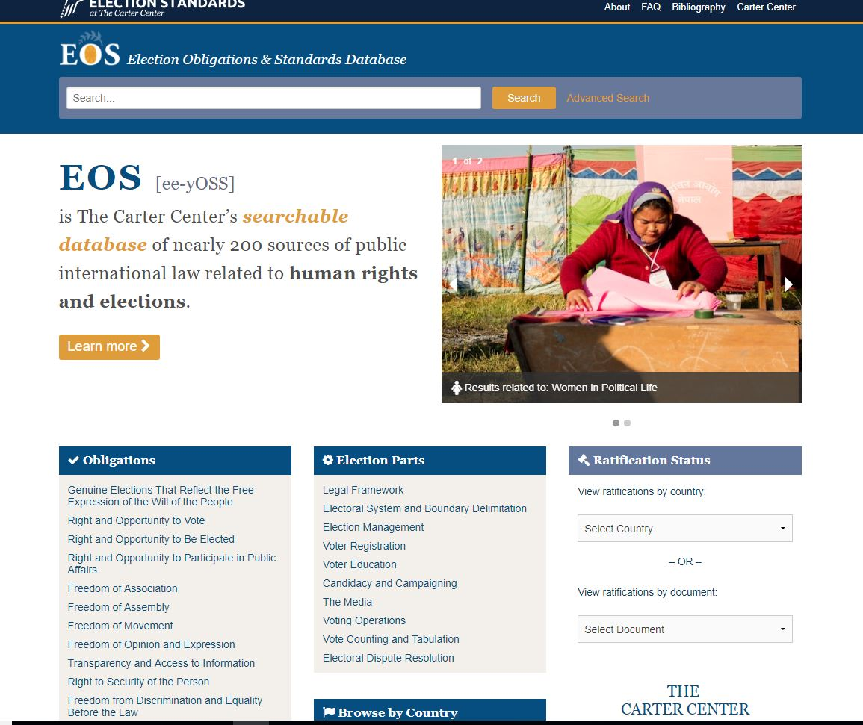
Notes:
Created in August 2010 originally as the Database of Obligations for Democratic Elections, EOS consolidates nearly 200 sources of international law related to human rights and democratic elections that can be used by international and domestic observers to assess elections.
Election observers can research a country’s ratified or endorsed international and regional treaties, as well as a wide range of other sources indicative of obligations. By anchoring election assessment to international obligations, citizens and observers are better able to hold governments accountable when assessing elections.

Slide 12
Questions?
Thank You

